Slide 1
CSE400: FUNDAMENTALS OF PROBABILITY IN COMPUTING
INTELLIGENT TRANSPORT SYSTEM
ROUTE OPTIMIZATION
UNDER GUIDANCE OF:
PROFESSOR DHAVAL PATEL & PRAPTI MAM
SECTION-1 GROUP-8

Slide 2
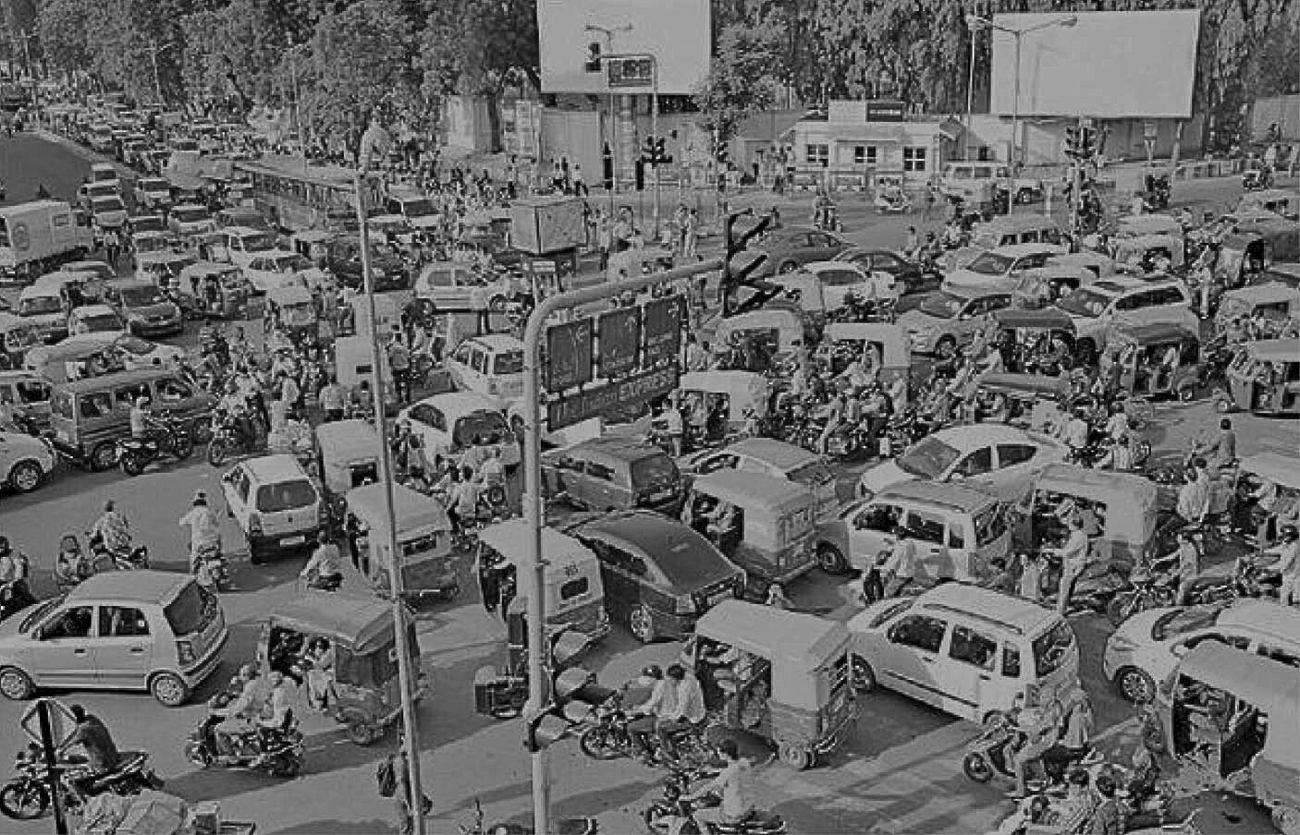
Tractable Pathfinding for the Stochastic On-Time Arrival Problem
2
  Real-world travel times are uncertain due to traffic congestion, signals, and incidents
  Deterministic shortest-path routing ignores variability and often leads to late arrivals
  In many applications, arriving on time is more important than minimizing expected travel time
  This motivates routing methods that explicitly model uncertainty and optimize reliability

Slide 3
Project Objective and Scope
  Objective: maximize the probability of arriving on time within a fixed time budget
  Routing is performed on road networks where edge travel times are modeled as random variables
  The entire path must be chosen before departure (offline decision-making)
  Applicable to logistics planning, scheduling, and pre-trip navigation

Slide 4
Project System Overview
  Input: road network represented as a directed graph
  Each edge has a probability distribution for travel time
  A source, destination, and time budget are specified
  System computes the path that maximizes on-time arrival probability
  Output: most reliable fixed path under uncertainty

Slide 5
Sources of Uncertainty in the Project
  Travel time on each road segment is uncertain and varies randomly
  Traffic congestion and environmental factors introduce variability
  Travel-time distributions are estimated from historical or modeled data
  Arrival time relative to the fixed time budget is therefore uncertain

Slide 6
KEY RANDOM VARIABLES AND THEIR ROLES
  Random travel time on each edge of the network
  Total travel time along a path (sum of edge travel times)
  On-time arrival indicator (arrival time ≤ time budget T)
  These variables determine the probability of successful on-time arrival
  They form the basis for evaluating path reliability

Slide 7
Probabilistic Models and Assumptions
  Edge travel times are modeled as independent random variables.
  Travel-time distributions are time-invariant.
  Traffic behavior is assumed to be exogenous.
  Total path travel time is computed using convolution of edge distributions.
  These assumptions simplify real traffic behavior but enable tractable probabilistic inference.

Slide 8
6
Probabilistic Reasoning and Inference Logic
  Uncertainty propagates through the network via convolution of distributions
  Reliability of a path is computed as the probability of total travel time ≤ T
  An optimal adaptive routing policy provides an upper bound on path reliability
  This policy is used to guide inference toward the most reliable path

Slide 9
Operationalizing Probabilistic Reasoning in the Project
  A best-first (A*-style) search algorithm is used
  Paths are expanded in decreasing order of estimated reliability
  The policy-based SOTA solution serves as an admissible heuristic
  Guarantees that the first complete path found is optimal

Slide 10
Current Limitations and Conceptual Gaps
  Assumes independence of edge travel times
  Does not fully model time-varying traffic conditions
  Path-based preprocessing does not scale well to very large networks
  Performance depends on quality of travel-time distributions

Slide 11
Planned Refinements and Role Coordination
  Incorporating correlated or time-dependent travel-time models
  Improving scalability for large metropolitan networks
  Exploring approximation techniques for faster computation
  Coordinating modeling, algorithm design, and evaluation across roles

Slide 12
Summary of Group-Level Understanding
  The project addresses reliable routing under travel-time uncertainty
  Focuses on the path-based Stochastic On-Time Arrival problem
  Uses probabilistic modeling and admissible heuristics for efficiency
  Demonstrates that reliable routing can be made tractable in practice
Reference
Niknami, M. and Samaranayake, S. (2016). Tractable Pathfinding for the Stochastic on-time Arrival Problem. In: Springer. pp.231–245.

Slide 13
Thank You!

